Slide 1
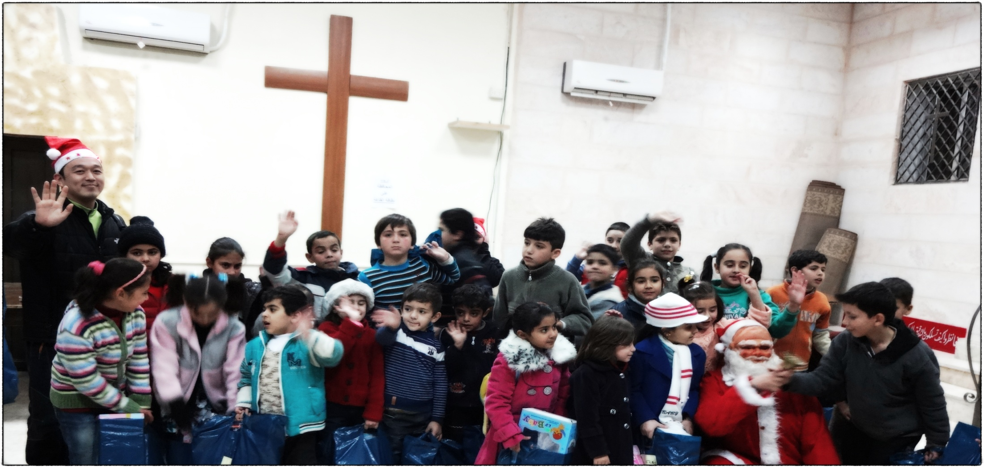
Diaconal Work of Korean Churches
May, 2015

Slide 2
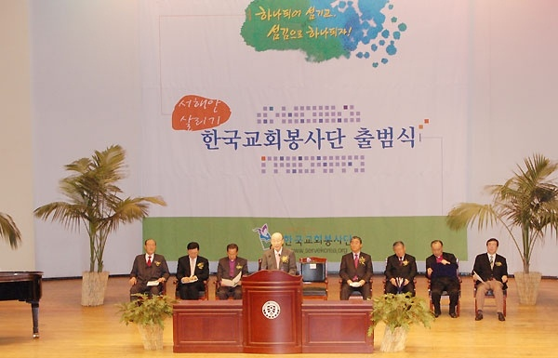
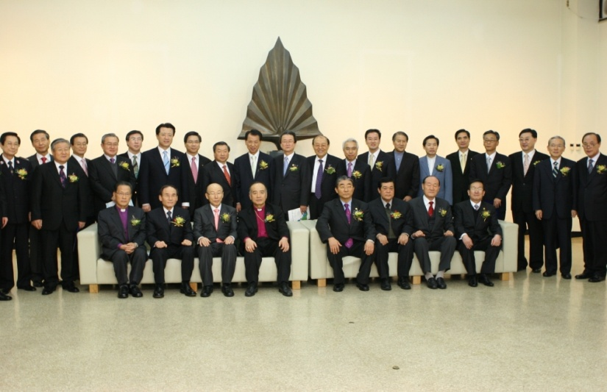
Who we are: About Korean Diakonia(KD)
KD is an ecumenical organization, comprising of 15 denominations in Korea with a focus
on diaconal work.
KD was based on the Korean Council of Christian Social Welfare that was founded in 2002.
KD was established in 2008 to make diaconal tasks of Korean churches which local churches or denominations have done individually under the umbrella term of Korean churches.
The motto of KD is “To be one by serving and to serve by being one.”

Slide 3
Organization
KD consists of three divisions including the Korean Council of Christian Social Welfare
in charge of work locally, World Diakonia in charge of work overseas, and North Korea Diakonia in charge of work related to North Korea.
Local Partners:
-Volunteering Korea
-Korean Disaster Relief
-Korea NGO Council for Overseas Development Cooperation
-Volunteering Fields in Mainline Korean Churches
Overseas Partners:
-Global Christian Organizations(e.g., WCC, Act Alliance)
-Various Missionary Churches around the World

Slide 4
The Divisions of Korean Diakonia
KOREAN DIAKONIA
Korean Council of Christian Social Welfare
WORLD DIAKONIA
NORTH KOREA DIAKONIA
Diakonia activities in Korea
Diakonia activities worldwide
Diakonia activities in North Korea
Secretariat

Slide 5
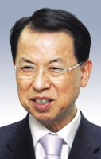
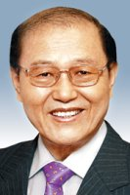
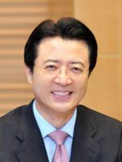
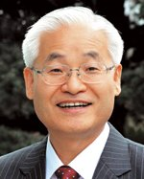
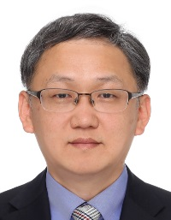
KD Leadership
Rev. Kim Sam Whan
(KD Moderator)
Rev. Son In Woong
(Korean Council of Christian
Social Welfare Chairperson)
Rev. Oh Jung Hyun
(World Diakonia Chairperson)
Rev. Jung Sung Jin
(Executive Director )
Rev. Cheon Young Cheol
(Secretary General)

Slide 6
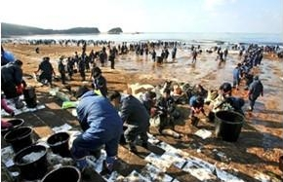
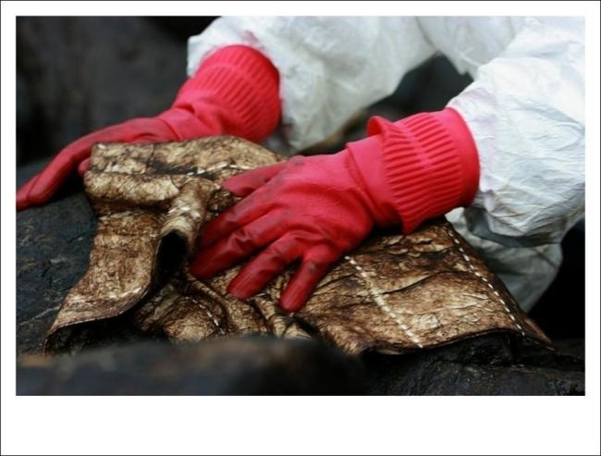
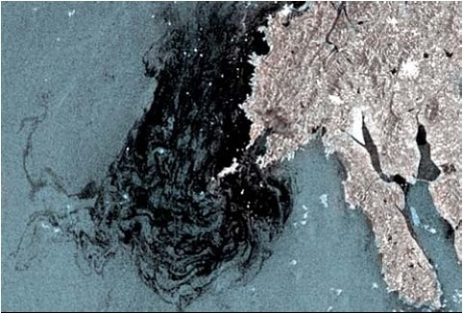
What we do: Local Activities, Highlight
The oil spill on the west coat of Korea
The oil spill on the west coat of Korea on March 12, 2007 happened at the coastal waters of Taean county, South Chungcheong Province due to the collision between Hong Kong oil tanker 'Hebei Spirit' and a floating crane 'Samseong 1'. This caused 8,000 hectares of fisheries and farms to be polluted in Seosan and Taean.
During this time 25 Protestant denominations came together which included
10,000 local churches and around 1.2 million Christian volunteers that worked
to prevent the spread of the spill and to help in other areas. These Christian
volunteers composed of 80% of total volunteers.
The KD arranged these activities as an ecumenical diaconal organization.

Slide 7
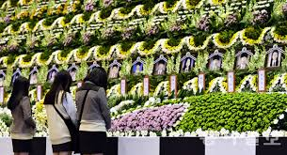
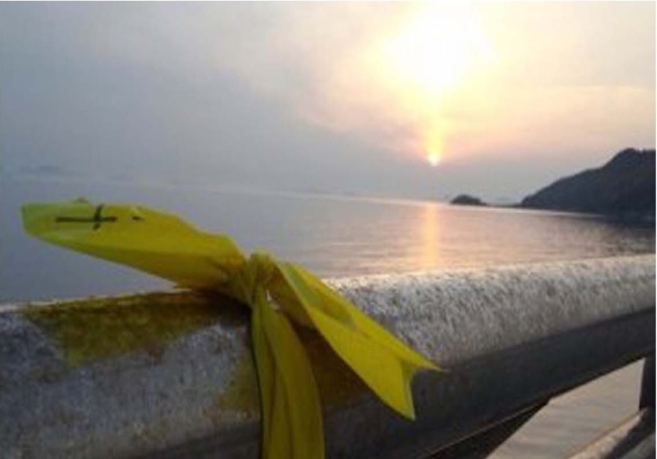
What we do: Local Activities, Highlight
The victims of the Sewol Ferry
The sinking of the MV Sewol occurred on the morning of 16 April 2014 en route from Incheon to Jeju.
The Japanese-built South Korean ferry capsized
while carrying 476 people, mostly secondary school students from Danwon High School.
304 passengers died in the disaster.
A fund was created for the victims of the Sewol
Ferry and other persons connected with the
incident by Korean Diakonia. A KD staff was sent
to Ansan (location of Danwon High School)
and works with staff members from other
organizations in the area to aid the victims.

Slide 8
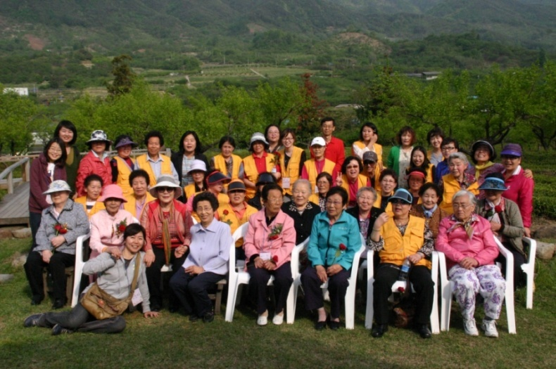
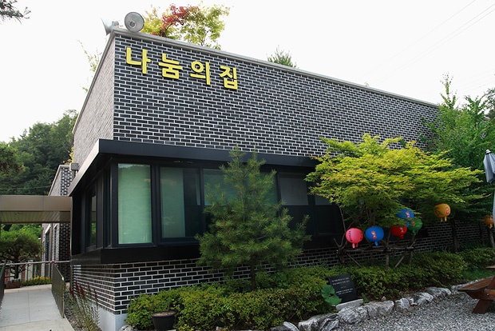
What we do: Local Activities, Highlight
The comfort women
Programs were created to aid the comfort women who were forced into sex
slavery during the time of Japanese occupation of Korea. Continual aid was given
to their new house titled 'Our Home' and also for another living space called
'Sharing Home‘ for 2010~2015. Organized a Wednesday Gathering were held along that demanded apologies and reparations for these women from
the Japanese government.

Slide 9
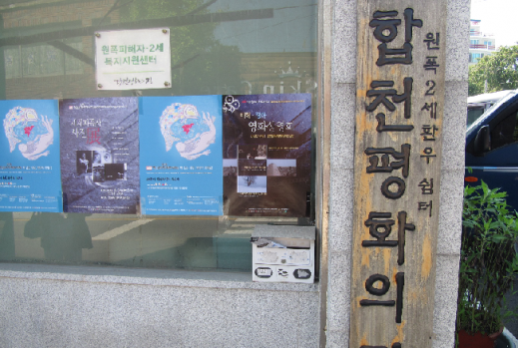
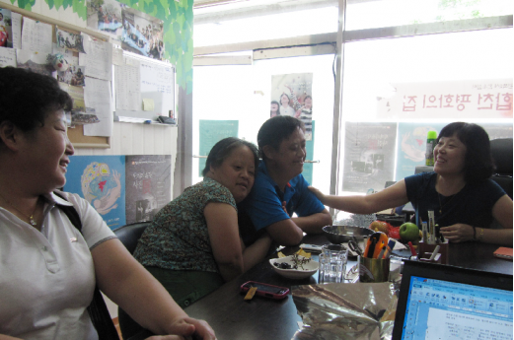
What we do: Local Activities, Highlight
Korean survivors from Nagasaki and Hiroshima
During the second World War, atomic bombs were dropped the Japanese
cities of Nagasaki and Hiroshima. 40,000 people out of 70,000 were killed
instantly. 23,000 survivors came back to Korea. The survivors and their
descendants suffer due to radiation. The KD has shared the stories of these
individuals and are working to get a special law passed on behalf of them.

Slide 10
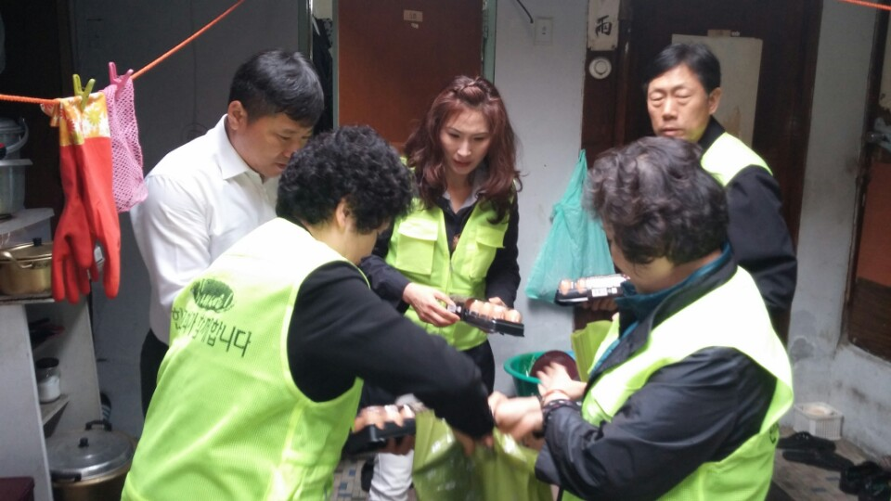
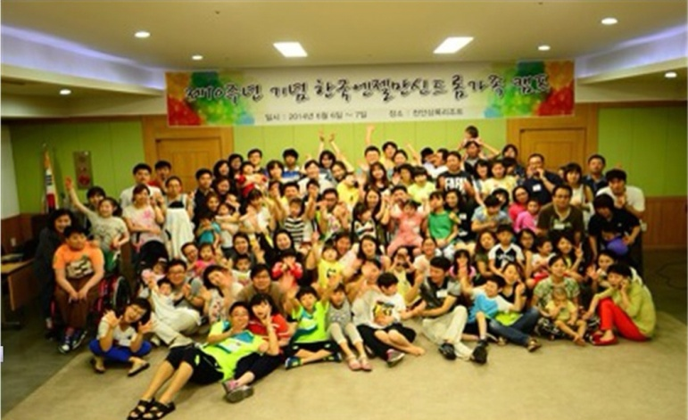
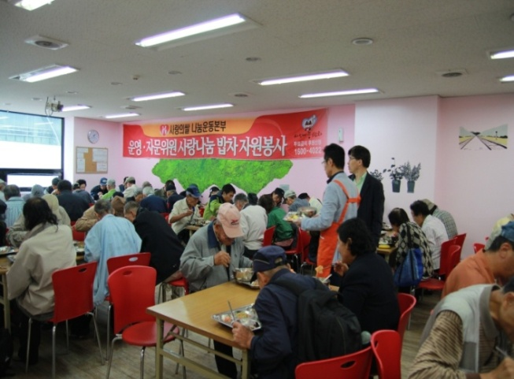
What we do: Local Activities, Highlight
Programs for alienated neighbors
The KD has spent time with the alienated neighbors during Christmas, Easter, and the major Korean holidays such as Lunar New Year Holiday and Full
Moon Harvest Holiday every year. These individuals include families in low
income housing, the homeless, multicultural families, migrant workers, the
displaced elderly, and those with incurable illness. Gifts and meals are shared during this time.

Slide 11
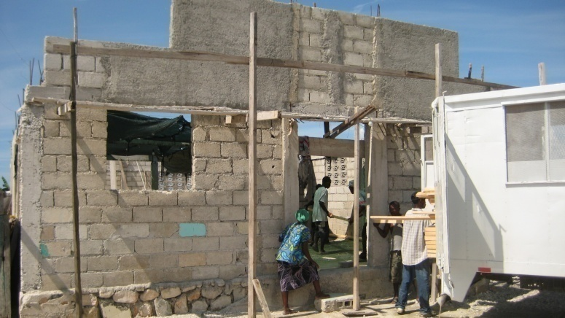
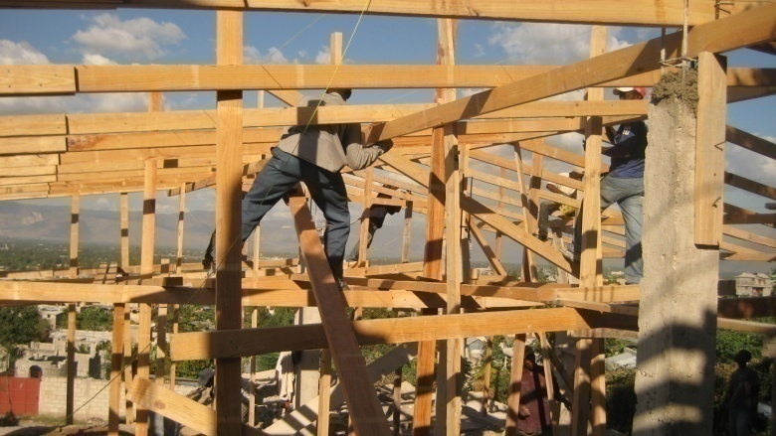
What we do: Overseas Activities, Highlight
Haiti Project
The World Diakonia (WD) of KD has raised fund from local churches in Korea for the Haiti Relief Fund to support the relief efforts after the Haiti earthquake in 2010.
The WD has reconstructed 70 elementary schools and local churches in Haiti from 2010 to 2011.

Slide 12
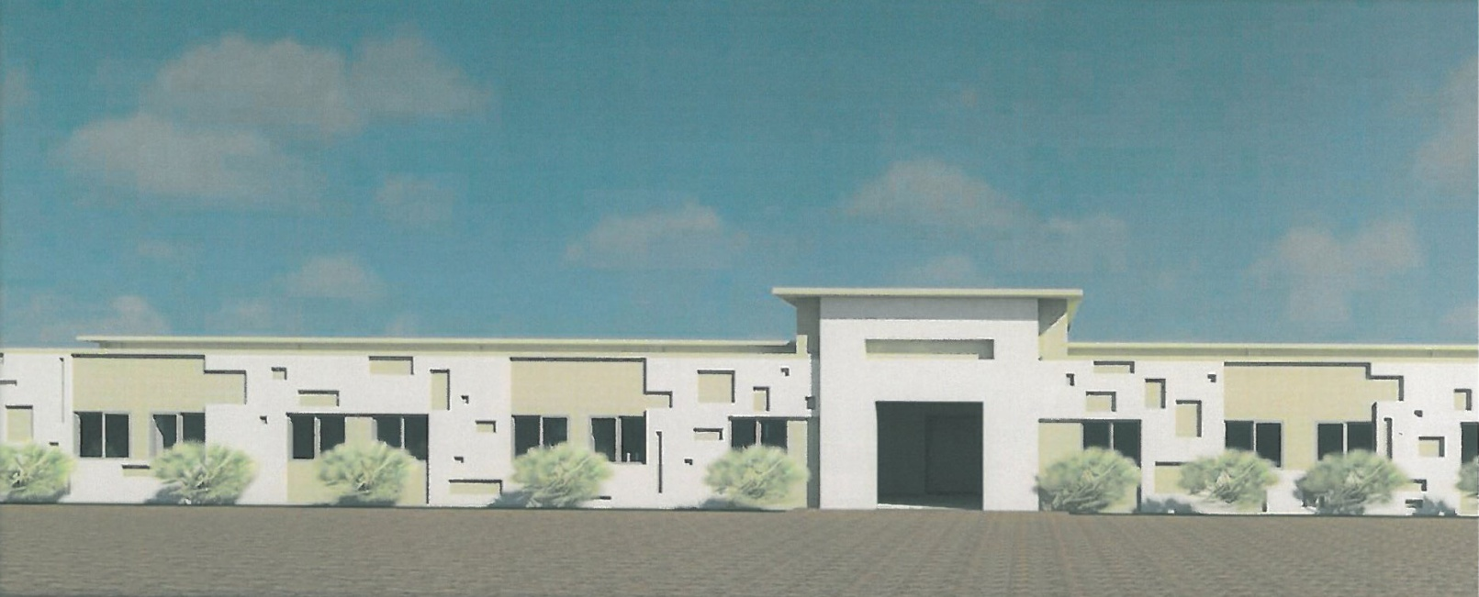
What we do: Overseas Activities, Highlight
Haiti Project (Long Term Project)
One long term project to support Haiti has the WD/KD has been conducting research and preparing a plan for the past 3 years from 2012 to 2014 to establish a vocational school at the Caracol Industrial Park in Haiti.

Slide 13
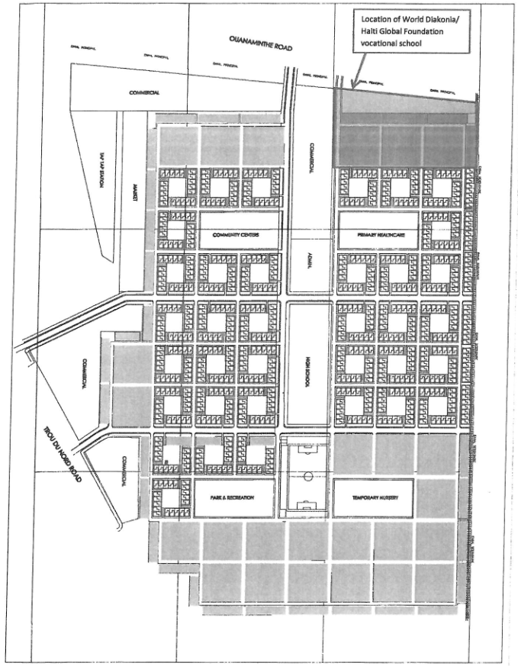
What we do: Overseas Activities, Highlight
Haiti Project (Long Term Project)
The Haitian government, through USAID,
provided a part of the Caracol
Industrial Park site to the World Diakonia
to establish a vocational school.

Slide 14
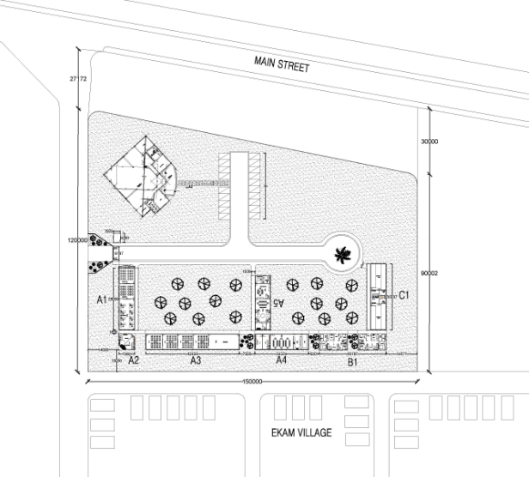
What we do: Overseas Activities, Highlight
Haiti Project (Long Term Project)
The WD/KD will construct the school buildings, including a dormitory by November 2015 and then a chapel by March 2016. If possible, the WD/KD hopes to open the school in November of this year.

Slide 15
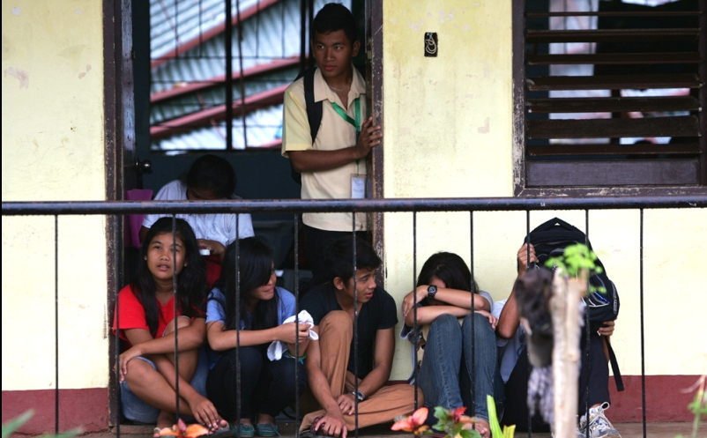
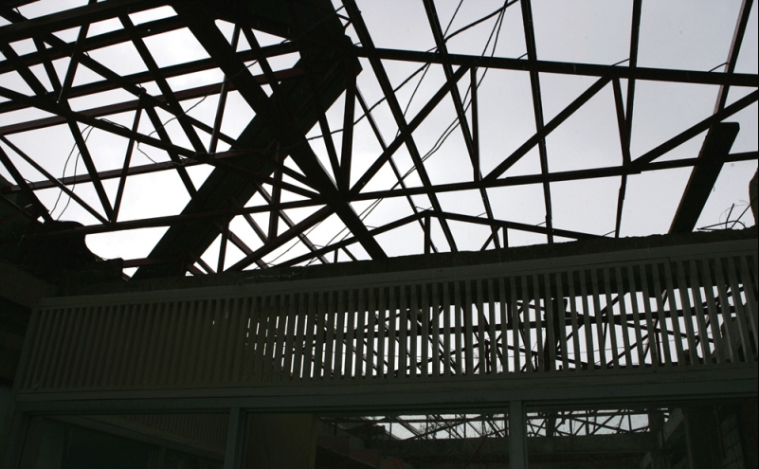
What we do: Overseas Activities, Highlight
The Haiyan typhoon in the Philippines and Indonesia
Relief efforts were conducted in the Philippines and Indonesia for those that have
been affected by the Haiyan typhoon along with other NGOs. Equipment was
supplied to build schools, houses and churches and emergency supplies are
continually sent for 2012~2013.

Slide 16
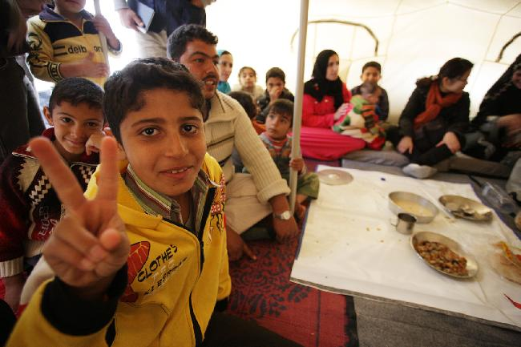
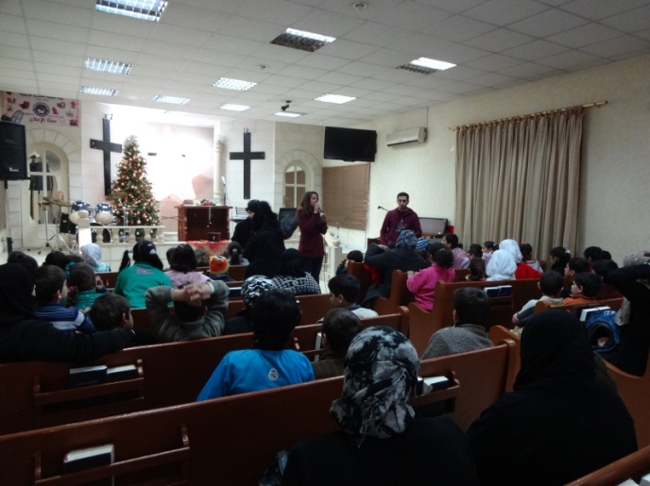
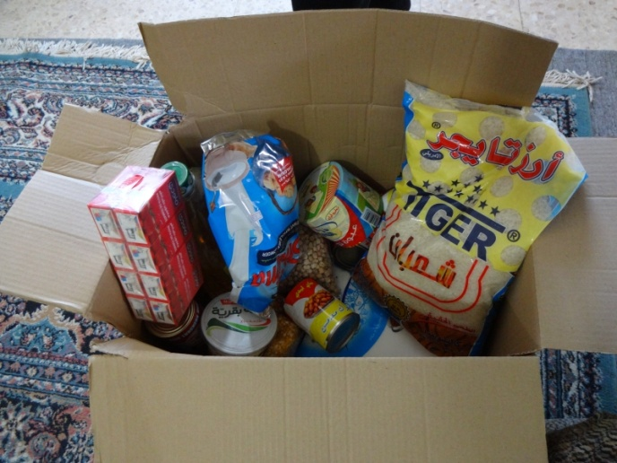
What we do: Overseas Activities, Highlight
Refugees in Syria and Palestine
A KD research team was sent to evaluate the situation in regards to aid
for refugees in Syria and Palestine. Through this research, the KD has sent daily necessities and food packages for 2012-2013.
Notes:
A KD research team was sent to evaluate the situation in regards to aid for refugees in Syria and Palestine. Through this research, the KD has sent daily necessities and food packages for 2012-2013.

Slide 17
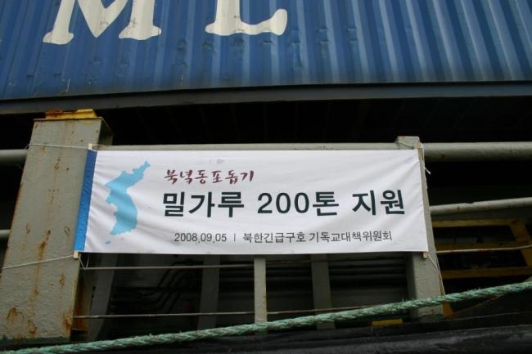
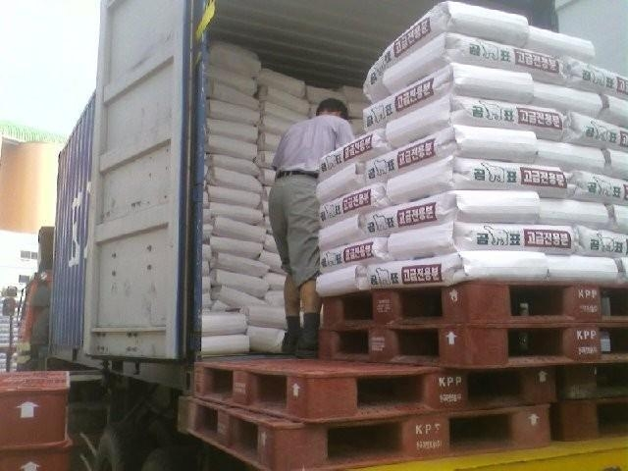
What we do: Aid to North Korea, Highlight
A Christian task force was created
to aid the brothers and sisters
in need in North Korea and
the work was arranged
by the Korean Diakonia.
100 tons of fertilizer and 500 tons of flour were sent to the (North)
Korean Christian Federation (KCF)
through World Vision and North-
South Sharing for 2011~2012.
Notes:
A Christian task force was created to aid the brothers and sisters in need in North Korea and the work was arranged by the Korean Diakonia.
100 tons of fertilizer and 500 tons of flour were sent to the (North) Korean Christian Federation (KCF) through World Vision and North South Sharing for 2011~2012. The KD worked with KCF in order to sent flour.

Slide 18
Diakonia Expo
Diakonia Expo looks at the reality of times of our isolated neighbors, and guides churches
with enlightenment to accept a new mission as diaconal work.
Objectives of Diakonia Expo (DK)
Purpose for Human Beings
DK seeks the demand and the need of isolated neighbors to contribute
to welfare improvement and propose hope by love of Christ.
Purpose for Churches
DK confirms diaconal work as an essential mission of church by a detailed practice of the Christian spirit.
Purpose for Society
DK looks over the history of the diaconal work and concentrates on the capabilities
as well as developing the sources and methods for the diaconal work in quality and quantity.

Slide 19
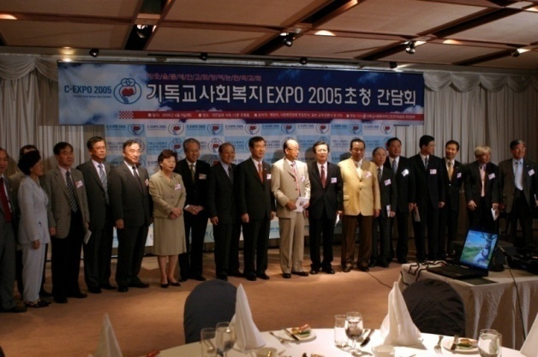
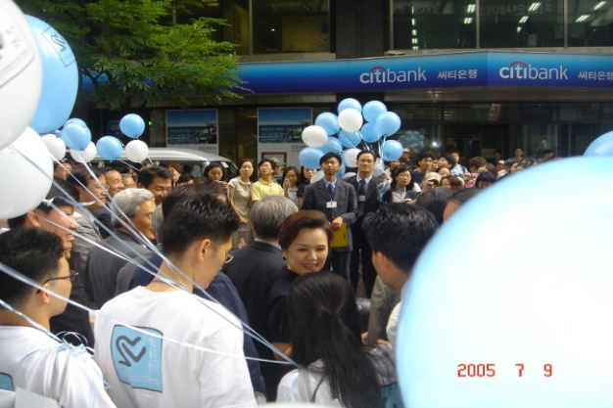
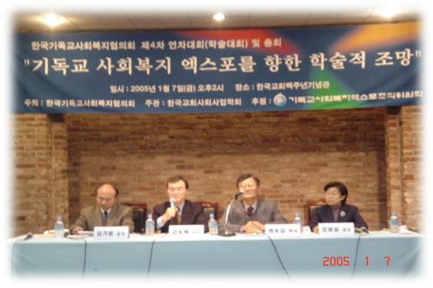
The First Diakonia Expo in 2005
Dates: August 24~28, 2005
Places: Seoul Square, Youngnak Presbyterian Church
Theme: The Korean Church Which Opens Hope With Our Neighbor

Slide 20
Diakonia Expo in 2005
Main Events:
International symposiums: Along with Christian academics from the United States, Japan and Korea, Christian views on social welfare were examined. In order for the Korean Church to systematically and expertly work in social welfare, the experiences and guidelines of social welfare work within the local church was presented. In order for the Korean church to be able to support the safety-nets of society, the areas of where actions are taken and other roles of the church were examined as well.
Church Leaders Meeting: This meeting looked at the crisis that the Korean Church was facing. It
suggested how there can be overcome and revival through diaconal work. There was also a time for
networking and sharing of information among the diaconal workers of the Korean church for program development and action.
An exhibition was presented that looked at missionary work in Korea from the beginning. It focused on social welfare in Korea among the isolated classes and working fully within the disadvantaged classes. It gave an historical background those that shared in love the Christian gospel and examples of these actions. Through networking and sharing there was time to evaluate the calling and vision of social welfare in the church.
Women's Meeting: 150 denominations were represented with the focus being on the Women's
Evangelization Organization and The Christian Council of Korea's Gender Equality Committee and
the Christian Resources of Community Welfare.

Slide 21
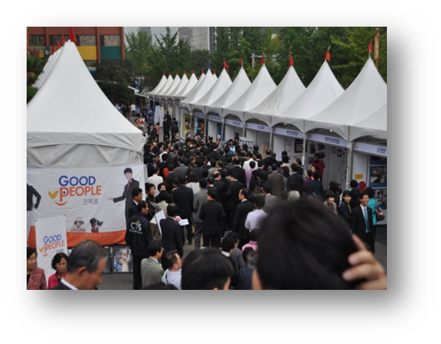
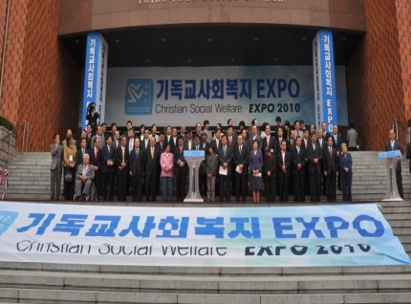
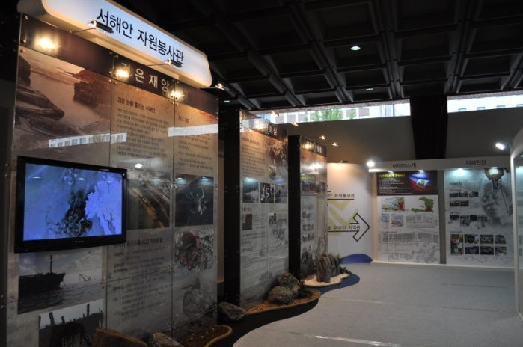
The Second Diakonia Expo in 2010
Dates: October 13~16, 2010
Places: Youido Full Gospel Church, Yeouido Han-River Park
Theme: Serving Joy, Sharing Happiness

Slide 22
Diakonia Expo in 2010
Main Events:
International Symposium: Following the 2005 symposium, Christian academics from the United
States, Japan and Korea, Christian views on social welfare were examined
Local Volunteers Meeting: The local volunteers meeting worked to vitalize and share information
about volunteer work within the Korean Church. It was through this meeting that a matured
direction for the church could be brought forth and systematic programs could be developed and
realized through networking.
Haiti Project Exhibition: In January of 2010, Haiti saw an 7.0 magnitude earthquake that caused
the destruction of 80% of buildings and 3 million people were effected by the earthquake. The KD worked with NGOs for the situation in Haiti. Korean churches created organizations within Haiti for the education of children along with facilities for welfare and education. Information about these
activities were shared during this exhibition.
Western Sea Volunteers Exhibition: This exhibition looked at the volunteer efforts at the Western Sea of Korea after the large oil spill of December 2007. Individuals lost their way of living and aid
was given in cleaning the oil spills and the goal was not to help but the slogan was to help those
people live. The stories of those 1.2 million people that worked in that area were shared during this time. Awareness was also given to the ecological change in that area and how the animals in
the area were being taken cared for after the oil spill.

Slide 23
The Third Diakonia Expo in 2016
2016 Diakonia Korea
Date: October, 2016
Place: Seoul Square, Sarang Prebyterian Church
Main Events:
International Seminar and Conference
Exhibitions
Field and Area events
Culture Events
Making Documentaries
Publishing 2016 Diakonia Expo White Paper and more.

Slide 24
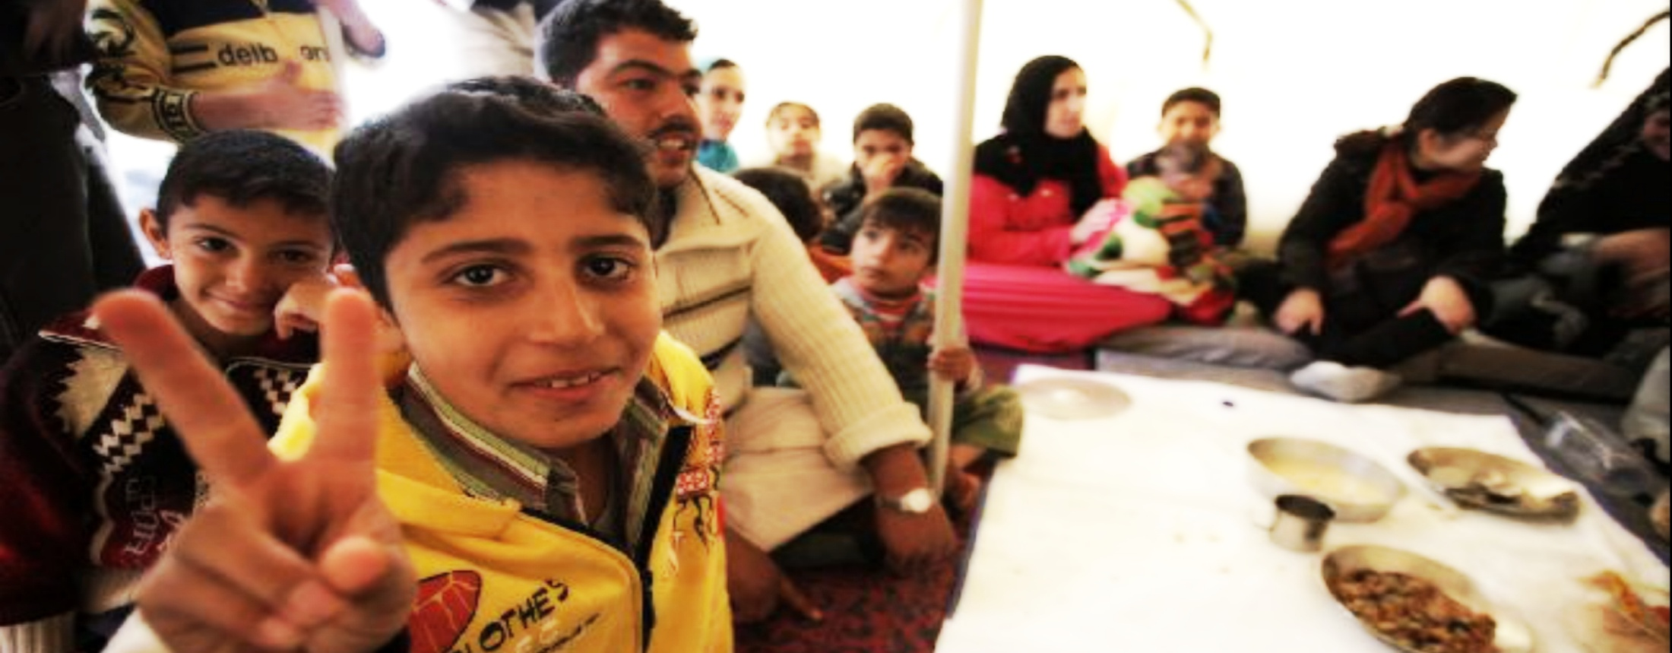
Thank You

